Slide 1
World War II

Slide 2
How did the war in Europe end and what were the peace conditions?

Slide 3
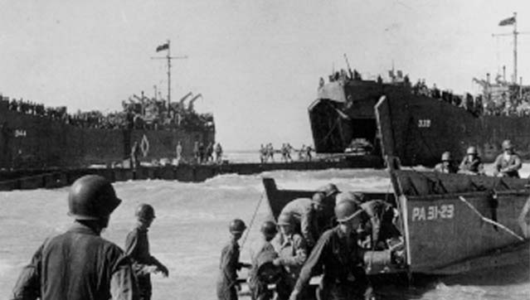
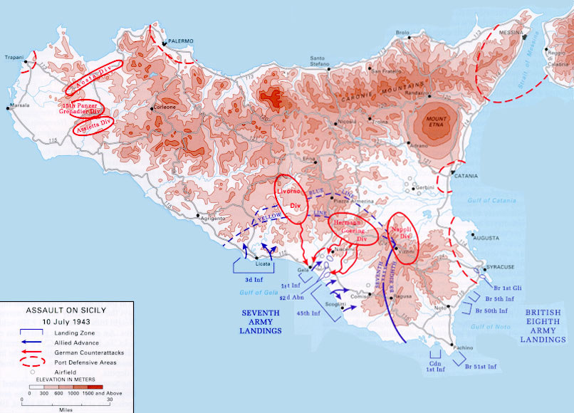
Allied victories in North Africa – defeat of Erwin Rommel’s Afrika Korps
Invasion of Sicily, then Italy itself (late 1943, 1944)
Operation Overlord – D-Day; June 6, 1944
Battle of the Bulge – last ditch offensive by Hitler in December 1944

Slide 4
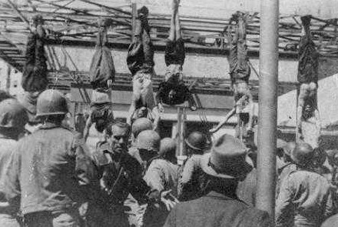
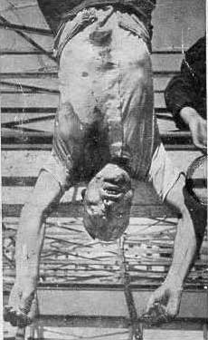
Mussolini killed while trying to escape Italy dressed as Nazi officer
Hitler committed suicide in late April 1945
Victory in Europe Day (V-E Day) – 5/8/45; Germany surrendered

Slide 5
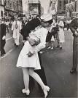

Slide 6
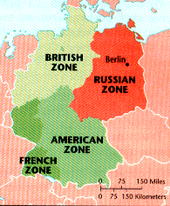
Peace Conditions
Yalta Conference— prior to the war’s end; Allies agreed to divide Germany (and its capital city) into 4 sections – U.S., British, French & Soviet
Also agreed to hold war crimes trials for leading Nazis – Nuremberg

Slide 7
10. Why did the US reject the idea of invading Japan in order to end the war? What did they do instead? How did the war in the Pacific end and what were the peace conditions?

Slide 8
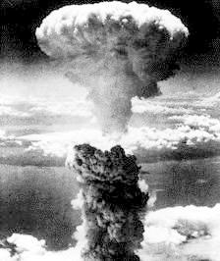
Truman decided to use the new weapon since Japanese resistance had increased the closer the Allies came to Japan
To end the war quickly, to convince Japan of their defeat, to save American lives

Slide 9
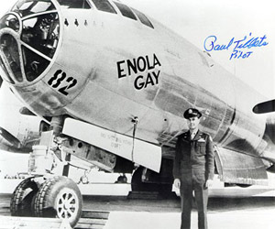
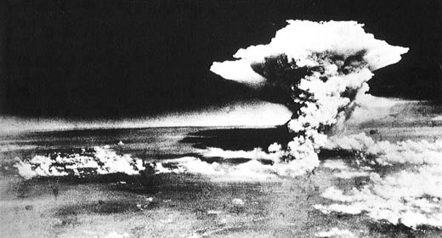
8/6/45 – “Little Boy”, dropped on Hiroshima by B-29 Bomber, Enola Gay
8/8/45 – USSR declares war on Japan, overran Manchuria
8/9/45 – “Fat Man” dropped on Nagasaki by B-29 Bomber, Bock’s Car
8/14/45 – Japan surrendered

Slide 10
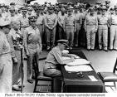
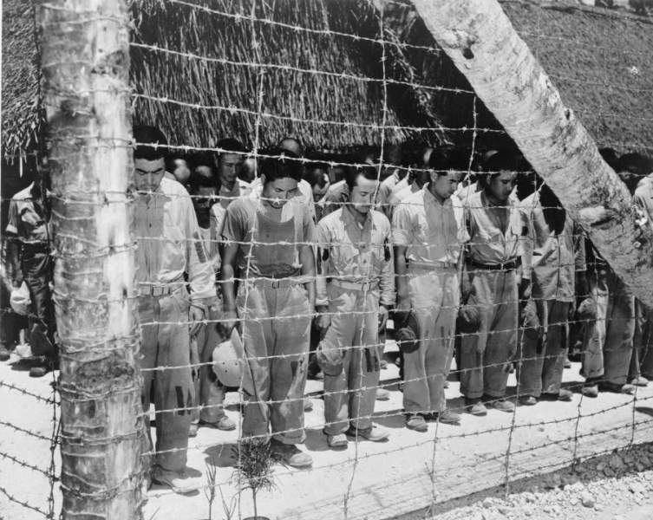
V-J Day
9/2/45 – representatives of Hirohito signed surrender terms aboard USS Missouri
Japan lost all land taken after 1875
Hirohito became a constitutional monarch
War crimes trials

Slide 11
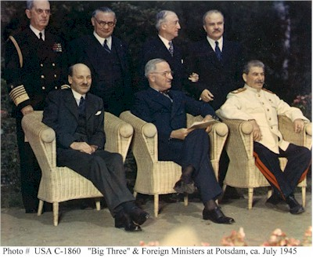
July of 1945 – Potsdam Conference
Big Three met
  USSR would declare war on Japan & invade Manchuria a.s.a.p.
  Korea would be occupied by Soviets N. of 38th parallel, by US S. of 38th parallel
  Japan – US occupied

Slide 12
11. (Part I) What wartime issues paved the way for the Cold War?

Slide 13
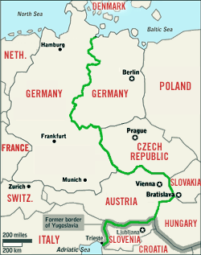
Cold War
War of words/ideas between US & USSR
Lots of conflicts in smaller countries (Korea, Vietnam, etc.)

Slide 14
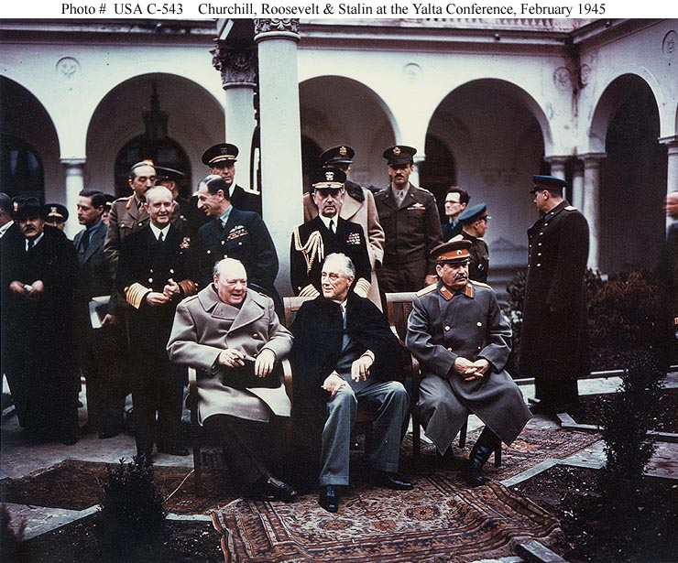
Yalta
Stalin wanted harsh terms for Germany to weaken them

Slide 15
(Part II) How did the U.S. and Soviet aims for the postwar world differ?

Slide 16
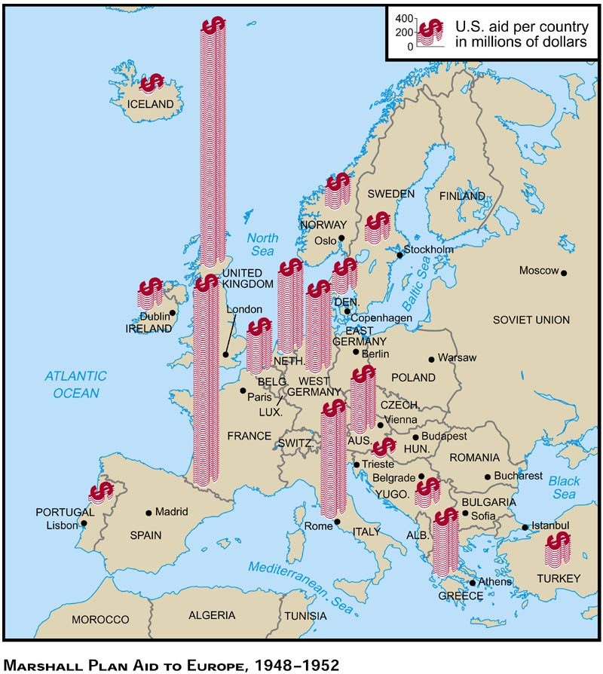
US Goals
Set up democracies in Europe
Form the United Nations

Slide 17
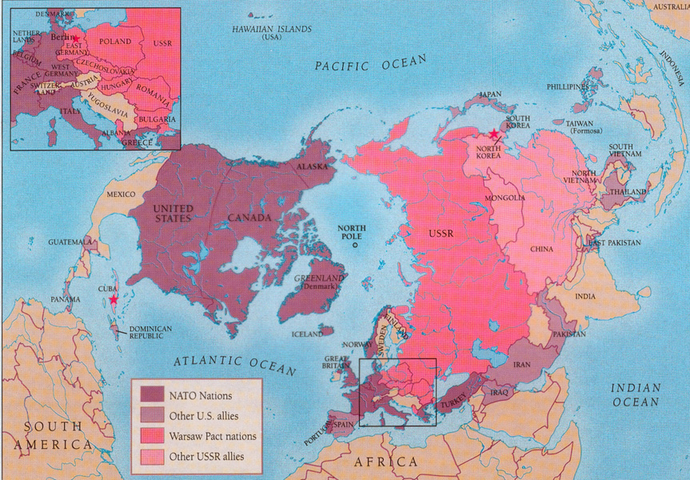
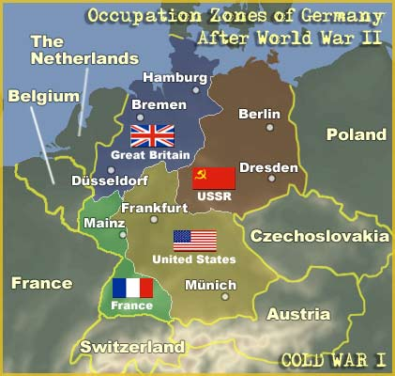
Prevent the spread of communism
$ and military aid to “friendly nations” to remain NOT communist

Slide 18
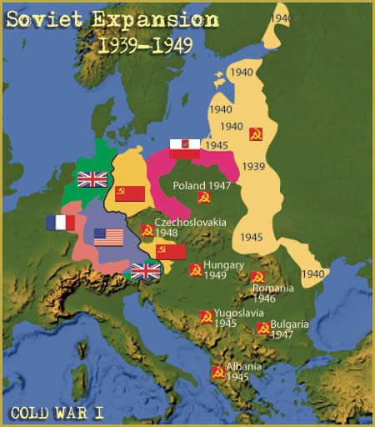
USSR Goals
Establish nations friendly to USSR (Communist)
Keep border nations weak

Slide 19

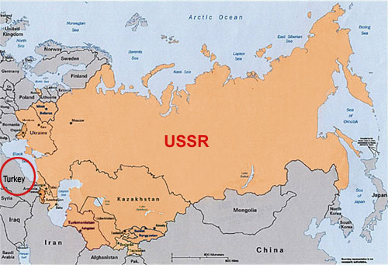
Rebuild economy
Control Communist Party in border nations

